Slide 1
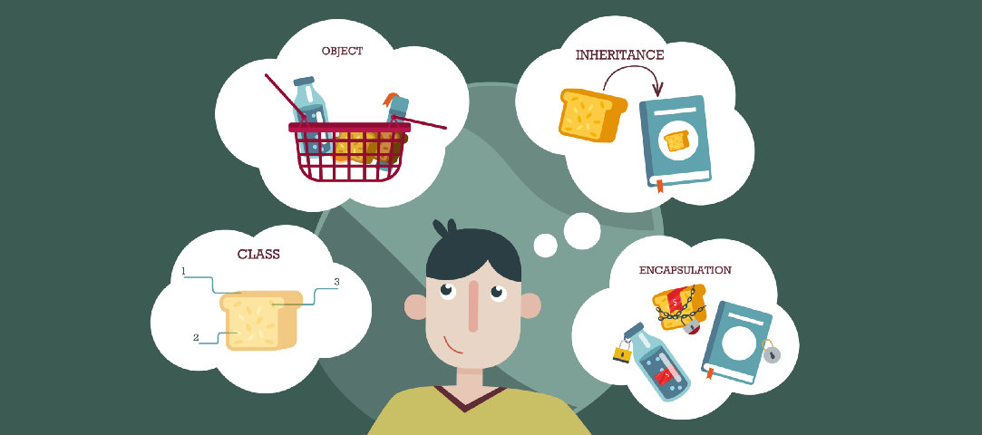
Lecture – 11 UML Basics: Inheritance, Association, Aggregation and Composition
Afsara Tasneem Misha
Lecturer
Department of CSE
Daffodil International University

Slide 2
Contents
UML Basics
- Generalization (Inheritance) – IS-A Relationship
- Association
- Aggregation
- Composition
– HAS-A Relationship

Slide 3
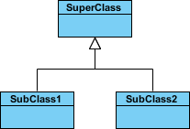
Topic - 1 : Inheritance (Generalization)
A generalization is a taxonomic relationship between a more general classifier and a more specific classifier.
Represents an "is-a" relationship.
SubClass1 and SubClass2 are specializations of SuperClass.

Slide 4
IS-A relationship
Bank
Human
Super // Generalization
extends
extends
DBBL
Boy
Sub // Specialization

Slide 5
Topic - 2 : Association
Relationship between two separate classes which establishes through their Objects. .
Also known as “has-a" relationship.
Each class is independent. They can exist without each other.
Course
Teacher
has
Customer
Product
buys

Slide 6
Two types of Association
Unary Association: Class A has Class B; But Class B does not have Class A
Binary Association: Both Classes know about each other.
has
A
B
Customer
Product
buys
has
has
A
B
Student
Teacher

Slide 7
Unary Association and Binary Association 1. Unary Association
Two types of Association
Customer
Product
buys
>
Customer Class will have the object of Product

Slide 8
Unary Association and Binary Association 2. Binary Association
Two types of Association
Student
Teacher

Slide 9
Unary Association and Binary Association 2. Binary Association (Solved by Association Class)
Two types of Association
Teacher
Student
Teacher
Student
AssociationClass

Slide 10
Topic - 3 : Aggregation and Composition
[Whole/Part Relationship]

Slide 11
3.1: Aggregation
Specified form of Association
Whole/Part Relationship
Class B is a part of Class A.
Both Classes are independent. Part class can exist without Whole Class.
A
B
Whole
Part
Car
Engine
Whole
Part

Slide 12
3.2: Composition
Specified (Stronger) form of Association
Whole/Part Relationship
Class B is a part of Class A.
The existence of Part class depends on Whole Class.
A
B
Whole
Part
Car
Window
House
Kitchen
Whole
Part

Slide 13
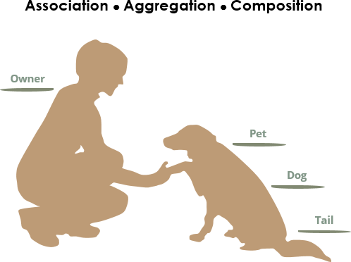
The figure below shows the three types of association connectors: association, aggregation and composition
We see the following relationships:
owners feed pets, pets please owners (Association)
a tail is a part of both dogs (Aggregation / Composition)
a dog is a kind of pet (Inheritance / Generalization)

Slide 14

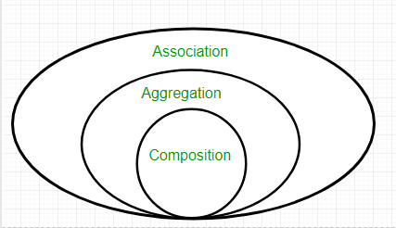



UML Notation
Inheritance

Slide 15
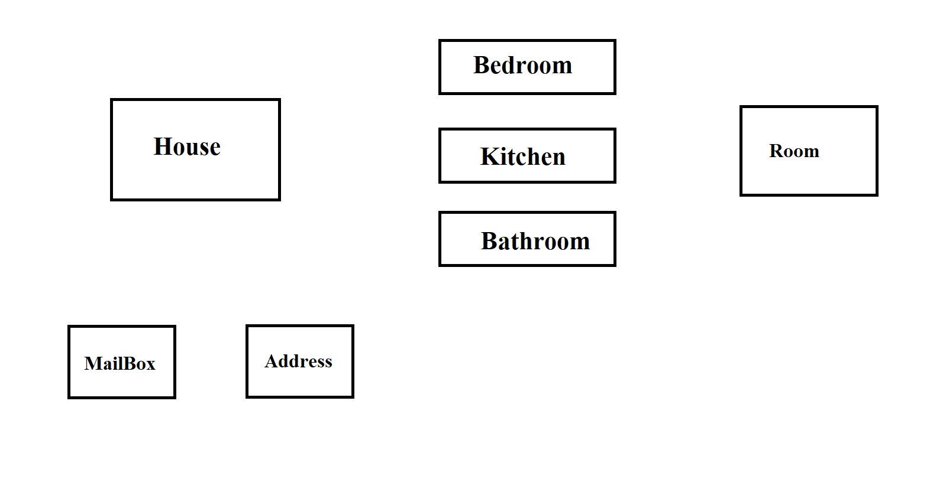
Example - 1

Slide 16
Example – 2: Description to UML
Volvo is a Car.
Every car has model and company of type string.
Volvo has price of type double, productionYear and registrationNumber of type string.
Volvo also has Engine and DashBoard.
Engine has capacity of type double.
DashBoard has size of type double.
Car provides drive and stop as abstract service or method of type void.
Volvo also provides changeFuel and checkBattery service or method of type void.

Slide 17
Example – 2: Description to UML
Volvo is a Car.
Every car has model and company of type string.
Volvo has price of type double, productionYear and registrationNumber of type string.
Volvo also has Engine and DashBoard.
Engine has capacity of type double.
DashBoard has size of type double.
Car provides drive and stop as abstract service or method of type void.
Volvo also provides changeFuel and checkBattery service or method of type void.

Slide 18
Solution of Example – 2: Description to UML
Volvo is a Car.
Every car has model and company of type string.
Volvo has price of type double, productionYear and registrationNumber of type string.
Volvo also has Engine and DashBoard.
Engine has capacity of type double.
DashBoard has size of type double.
Car provides drive and stop as abstract service or method of type void.
Volvo also provides changeFuel and checkBattery service or method of type void.
Car
#model : String
#company: String
+ drive () : void
+ stop () : void
Engine
-capacity : double
Volvo
- price: double
- productionYear: String
- registrationNumber: String
DashBoard
-size : double
+ changeFuel() : void
+checkBattery () : void

Slide 19
Solution of Example – 2: Description to UML
Volvo is a Car.
Every car has model and company of type string.
Volvo has price of type double, productionYear and registrationNumber of type string.
Volvo also has Engine and DashBoard.
Engine has capacity of type double.
DashBoard has size of type double.
Car provides drive and stop as abstract service or method of type void.
Volvo also provides changeFuel and checkBattery service or method of type void.
Car
#model : String
#company: String
+ drive () : void
+ stop () : void
Engine
-capacity : double
Volvo
- price: double
- productionYear: String
- registrationNumber: String
DashBoard
-size : double
+ changeFuel() : void
+checkBattery () : void

Slide 20
Example – 3: Try Yourself
Apple is a fruit
Apple has color and origin
Apple has Sticker
Sticker has logo

Slide 21

Thank you!

